Slide 1



Smart India Hackathon
Basic Details of the Team and Problem Statement
Solution Title: CODECREW- Smart Learning Spaces with Dynamic Timetable Scheduling
:Problem Statement Solution: Smart Classroom & Timetable Scheduler
Team Name: TEAM CODECREW
Team Leader Name: PRINCE RAWAT
Team Id : 60
Institute Name: BENNETT UNIVERSITY, TIMES GROUP Of INDIA
Theme : Smart Education
Organization :
Government of Jharkhand

Slide 2
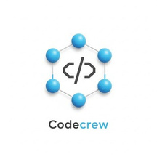

STUDIA: Smart Learning Spaces with Dynamic Timetable Scheduling
PROBLEM ADDRESSES
BUSINESS MODEL
●
Time inefficiency in manual scheduling
Clashes in classes, electives, and faculty timings.
Poor infrastructure utilization.
Uneven faculty workload.
Inability to adapt to real-time changes
Lack of workflow/review system.
Scalability issues with multi-department scheduling
Student/Faculty dissatisfaction.
Non-compliance with NEP 2020 flexibility needs.
Subscription-Based SaaS Model
Institutions pay a monthly/annual subscription to access the platform, with tiered pricing based on student/faculty strength.
B2B Institutional Partnerships
Partner with schools, colleges, and universities for bulk deployment, long term contracts ensure recurring revenue and scalability.
Data-Driven Insights & Reports
Provide anonymized analytics on student engagement, class utilization, and performance trends as paid insights for institutions or policymaker.
●
●
●
●
●
●
●
●
IDEA/APPROACH DETAIL
INNOVATION & UNIQUENESS
●
Faculty workload balance.
Student learning load distribution.
Classroom/lab allocation efficiency.
Minimization of timetable clashes.
Dynamic, Real-Time Adjustments.
Utilization rates of rooms/labs.
Student schedule distribution.
●
Automated, error-free timetable generation.
Increased classes and lab utilization efficiency.
Balanced workload for both faculty and student.
Enhanced student satisfaction with fewer timetable clashes.
Support for NEP 2020 flexibility (multidisciplinary and elective based learning).
Help in data-driven academic planning.
●
●
●
●
●
●
●
●
●
●
●

Slide 3
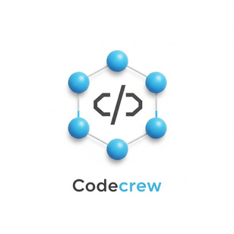
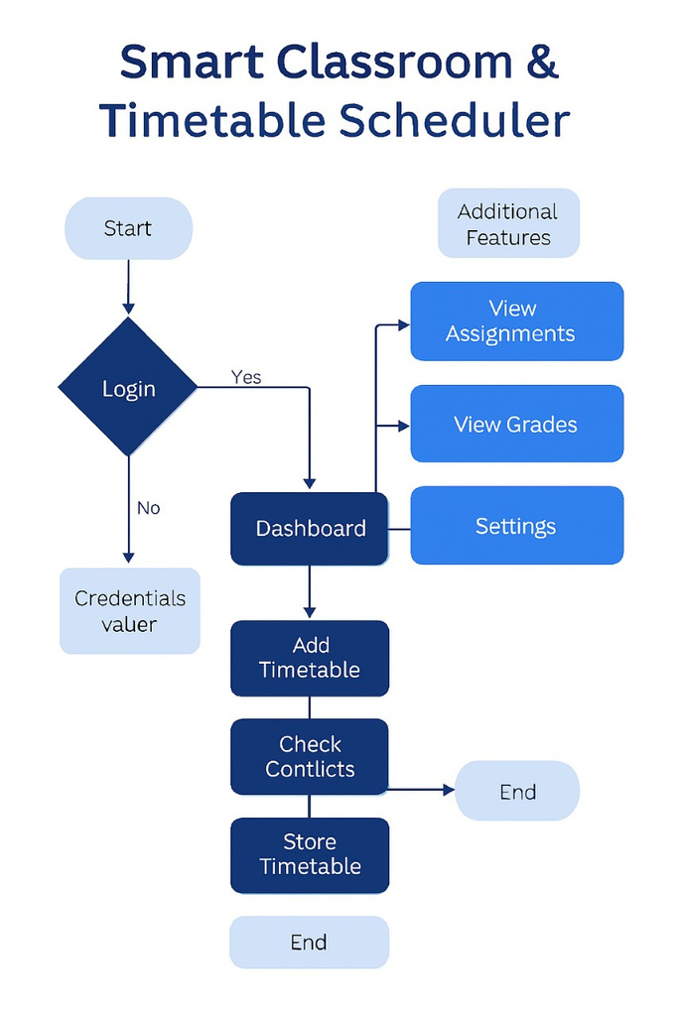
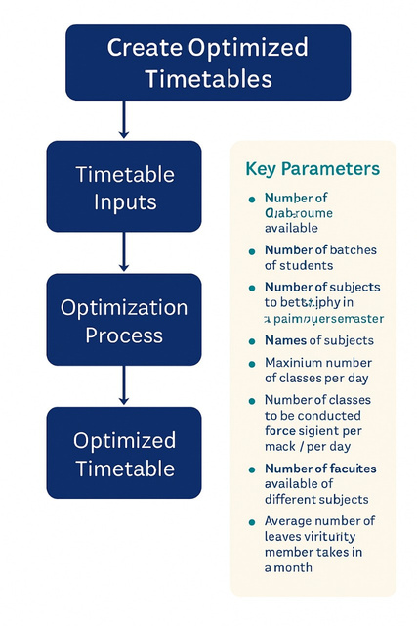
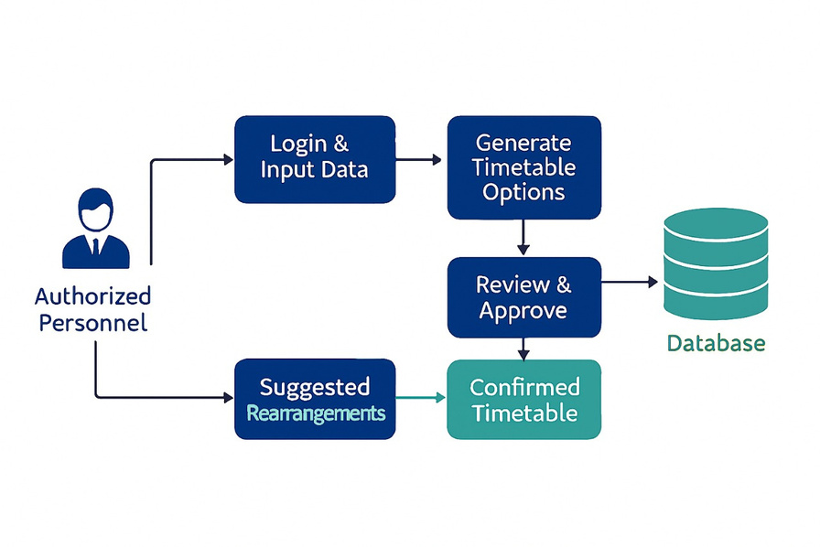
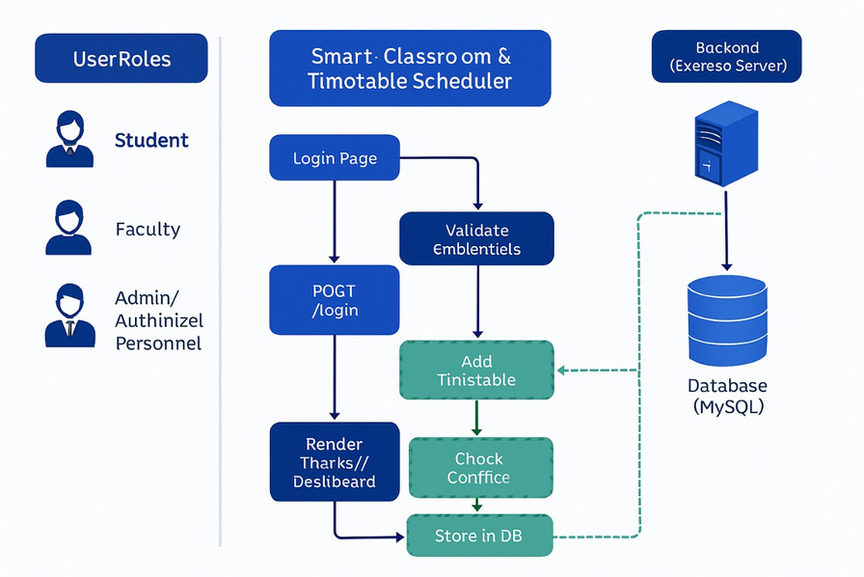
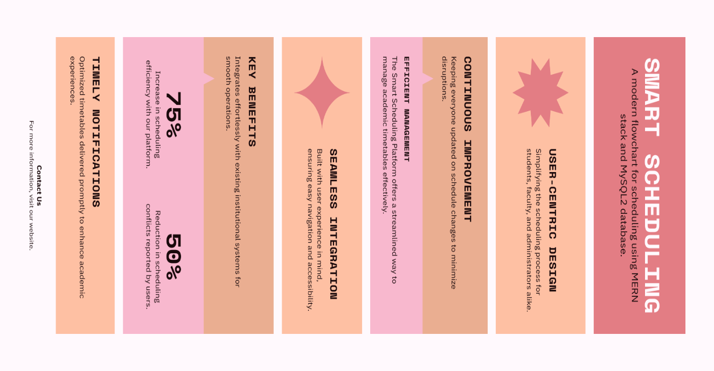







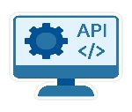













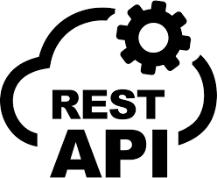





Technical Approach
PROCESS FLOW
MODEL EXPLANATION
TECH STACK
IMPLEMENTATION

Slide 4
FEASIBILITY AND VIABILITY
FINANCIAL FEASIBILITY
Analysis of the feasibility of the Idea
Potential Challenges & Risks
Strategies for Overcoming These Challenges
Available Technology and AI/Optimization Readiness
Integration Capability and Scalability
Real-Time Adaptability and Ease of Use
Decision-Making
Cost-Benefit Ratio
Data Accuracy & Completeness
Algorithmic Complexity
Real-Time Adaptability
Scalability Issues
Integration with Existing Systems
Security & Access Risk
Dynamic and Adaptive Scheduling
Infrastructure Optimization
Scalable and Web-Based Platform
Student-Centric Flexibility
Data-Driven Decision Making
Workload Balancing for Faculty
UNIQUE SELLING POINT ( USP )
● STUDIA provides conflict free scheduling
● STUDIA works across all departments, and it is easily accessible to multishift colleges
● STUDIA solves the issues of time (lag, and slow processing) that we found on many platforms
● STUDIA has a special admin access which can control whole website

Slide 5








IMPACT AND BENEFITS
Al-driven scheduling without manual clashes
Room changes, or cancellations via App notifications.
Admin dashboards showing classroom utilization, faculty workload trends, and student learning distribution, helping institutions plan resources better.
●
●
Students can view personalized and receive reminders.
Real-time adaptability to changes (faculty availability, room changes)
Supports multidisciplinary and elective-based learning
●
How will this help us?
DEPENDENCIES/SHOW STOPPER:
●
Accurate Input Data: Correct faculty availability, subject details, classroom capacities, and student enrollment numbers.
Enhances satisfaction and reduces timetable stress.
●
●
Administrative Support: Cooperation from departments and faculty in sharing scheduling constraints.
●
●
Policy Alignment: Compliance with institutional rules, teaching norms, and NEP 2020 flexibility guidelines.
●
●
Technology Stack: Stable frameworks for development (React/Angular for frontend. Nodejs-Express is for backend)
●
Instant updates to students and faculty about class rescheduling.
●
●
Database System: Reliable relational (MySQL) or NoSQL (MongoDB) for managing institutional data.
Integration APIs: Possible need to connect with ERP, LMS, attendance management systems.
●

Slide 6






RESEARCH AND REFERENCES
Jharkhand, once a hub of academic excellence and diversity, has seen its educational vibrancy fade post-statehood due to rising regionalism, political focus, and lack of new institutional development.
Jharkhand is rolling out a series of transformative reforms aimed at improving access, equity, and quality in education. Here are the key initiatives:
🌐 Digital & Data Initiatives: A student progress tracking system is being developed to monitor academic outcomes.
Expansion of digital learning materials and teacher training programs is part of the NEP 2020 implementation strategy[2].
LINK:-
https://qr.ae/pCIsGk
LINK:-
https://youtu.be/pVOfoaUDe-I?feature=shared
Here's a concise summary of the key outcomes and initiatives from the
Department of School Education & Literacy, Jharkhand: 📘 Vision & Mission
📢 Recent Notifications
🏫 Educational Resources
🌟 Best Practices & Programs
Reference APPs:-
LINK:-
https://schooleducation.jharkhand.gov.in
Chrome
Youtube
Quara
@SIH Idea submission- Template

